Slide 1

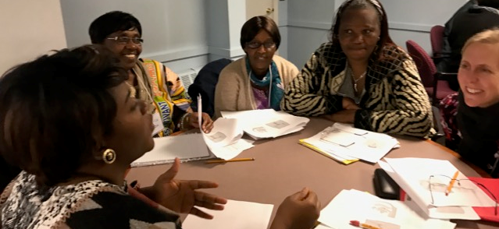
Oral Health in Immigrant Communities
Claudette NDAYININAHAZE
ABUSANA Micky Bondo
IHP Co-Founders
Introduction
Successes
The goal of In Her Presence (IHP) is to create and increase educational opportunities and provide access to knowledge through high level training; to empower more women and girls to reduce systems of inequity; to advocate for themselves and their families; to understand, to analyze and to assess the impact of racial injustices; and learn tools to combat inequities. To address health equity, IHP developed a program called “ heal your body.” which was designed to help families overcome these barriers. As part of this, IHP provides mothers with oral health education to help mothers practice preventive oral health care with their children.
The disparity in dental caries between children of newcomers and their mainstream children can be reduced by improving their parents' literacy in the official language(s) and educating parents regarding good oral health practices. IHP has done a series of family literacy trainings and conducts in-person interviews to understand barriers and perceptions. The families that participate in this programming are better able to advocate for themselves and their children, and more equipped to help their children practice oral health prevention.
The Challenge
Looking Forward
The Problem
Of the families IHP works with, all the asylum seekers and almost half of the immigrants found it difficult to get an appointment to get an appointment with a dentist. It is extra challenging for asylum seekers as they are not qualified to receive Maine Care. These families face a variety of obstacles, including a lack of nearby dental clinics, language barriers, and a shortage of providers who accept individuals enrolled in Medicaid. Many refugees, especially refugee children, have not had access to dental care for many years; have never had tooth-brushing education; and have suffered fractured teeth, tooth decay and dental abscesses. Asylum seekers and immigrants have a need for acute and basic dental treatment and health education.
There are many solutions to this challenge, including advocating for policy change to help refugee and asylee children qualify for MaineCare, integrating oral health into the overall healthcare system, encouraging more dentists to accept MaineCare, ensuring that oral health care can be affordable for all, and removing barriers put up by U.S. immigration policies that prevent immigrant from getting their children needed dental care.
IHP will be working with community liaisons and stakeholders to have conversations to understand the current status of oral health access for the immigrant community and to communicate to providers how the immigrant community is experiencing oral health inequity, with the goal to obtain advice about how to fix this problem. IHP will also support policies which improve oral health access and integrate oral health care into primary care settlings.
The work to improve policies, education and advocacy must start with grassroots organizations. Foundations have to invest longer-term in grassroots organizations serving our most vulnerable populations so we can educate families about the importance of oral health and build ambassadors in these populations to become advocates for change.
Many healthcare practitioners and policymakers are unaware of the importance of oral health for refugees and asylum-seekers. An appropriate oral health policy remains crucial for marginalized populations in general, and newcomer children in particular. Many refugees and asylum-seekers arrive in Maine without access to proper healthcare or sanitation, and are often unable to qualify for MaineCare. Helping parents prevent oral health problems with their children is critical since navigating the oral health care system in Maine is extra challenging for this population.
For more information: ABUSANA Micky Bondo | (207) 331 - 7811 | contact@inherpresence.org | www.inherpresence.org

