Slide 1
Aroostook Oral Health Project
June 15, 2021
Emily Leach, University of New England College of Dental Medicine (4th year dental student)
Shameem Fakory, University of New England College of Medicine (2nd year medical student)
Norma Desjardins, St. Apollonia Dental Clinic
Becca Matusovich, Partnership for Children’s Oral Health

Slide 2
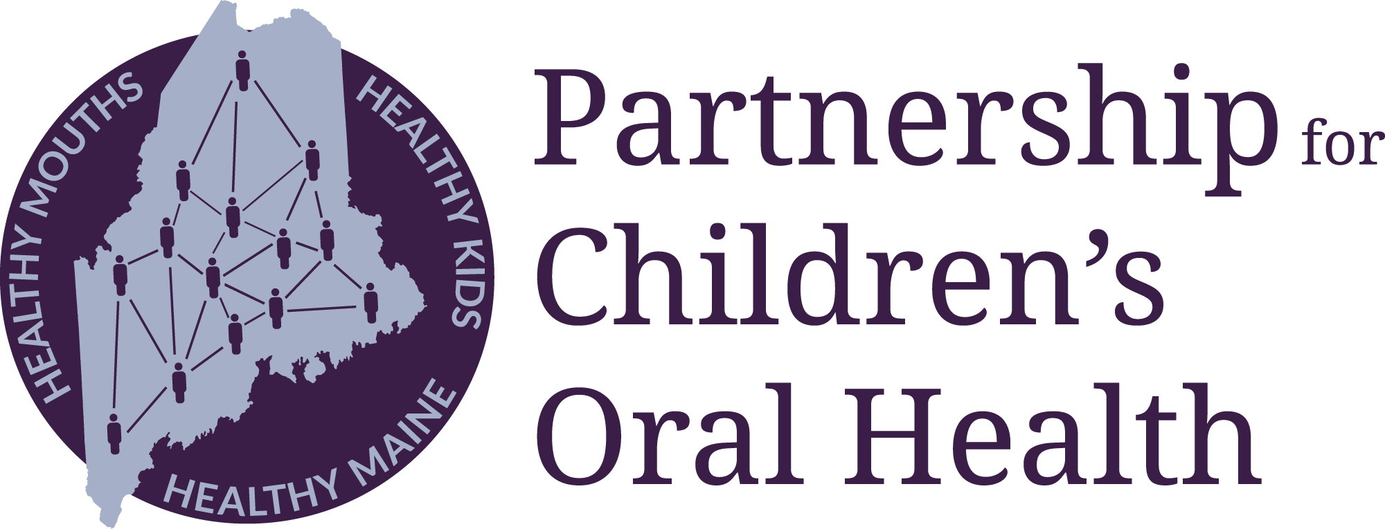
A network to ensure all Maine children can
grow up free from preventable dental disease
Shared Mission
Transform Maine into a state where we
meet the oral health needs of all children and families,
prioritize prevention, and
address oral health as a key element of overall health and economic well-being.
PCOH Network Initiatives
Collaborative work by many partners
Action teams
Innovation Projects
Advocacy for Systems Changes
Strategic Priorities
1. Integrate oral health into primary & prenatal care
Legacy initiative: From the First Tooth
2. Preventive care in school and community settings
3. Access, Quality, and Sustainability
For more info:
www.mainepcoh.org
Becca Matusovich, Executive Director
becca@mainepcoh.org
Kalie Hess, Associate Director
kalie@mainepcoh.org
PCOH Backbone Support
501c3 organization (2 Staff)
PCOH Board
Partnership Council
Consultants and contractors
Core operational funding from the Sadie and Harry Davis Foundation
Collective Vision
All children in Maine can grow up free from preventable dental disease

Slide 3
The current reality of children’s oral health in Maine
Challenges:
Almost half of kids in Maine are not getting regular preventive dental care
Oral surgeons and pediatric dentists are especially in short supply
The economics of providing dental care, especially in rural areas and for MaineCare and uninsured families, are very challenging - even non-profit dental centers must fill revenue shortfalls with grants in order to keep their doors open
COVID has exacerbated pre-existing access challenges by decreasing provider capacity, increasing provider costs, changing home-care routines, and delaying preventive care
Preventive dental care among Maine children under age 21 with dental coverage, 2019
Note: these graphs reflect the rates among children with consistent coverage (i.e. 11+months of either MaineCare or commercial dental insurance in 2019).
Source: 2019 dental claims data from the Maine Health Data Organization’s All-Payer Claims Database

Slide 4
Aroostook County Trends: Children’s Oral Health Needs
Shameem Fakory, MPH, OMS-I UNECOM
Emily Leach, D4 UNECDM

Slide 5
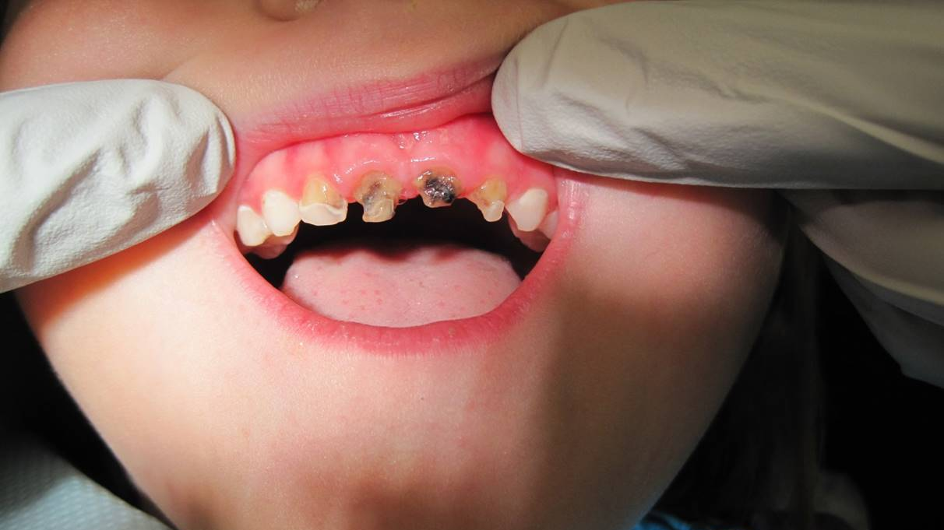
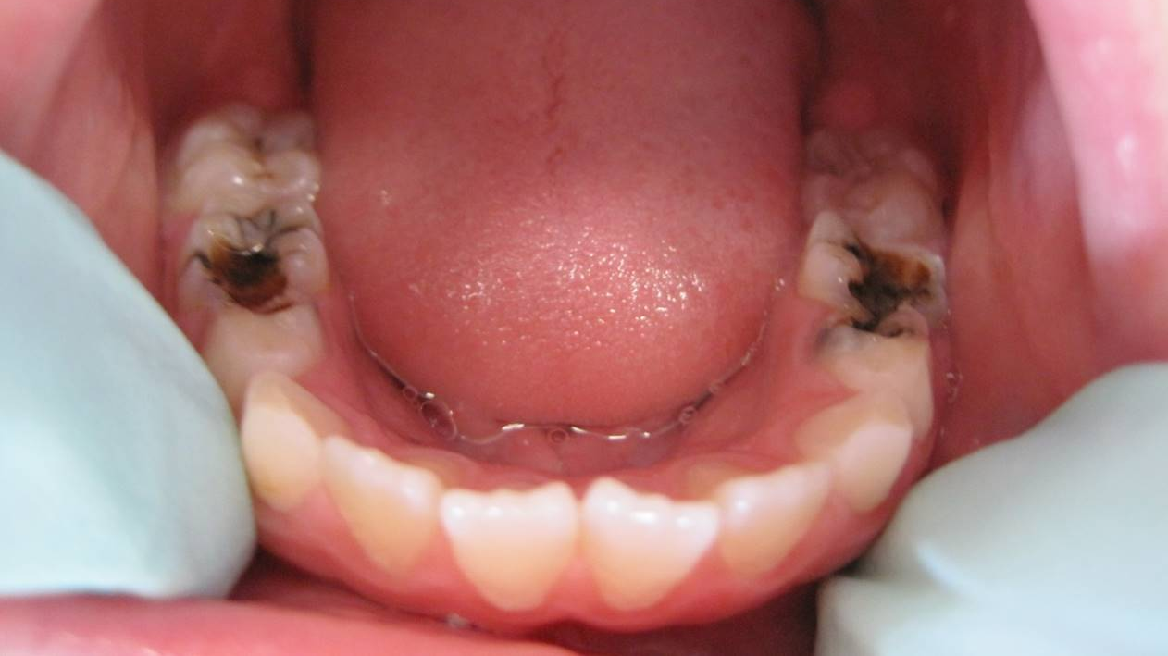
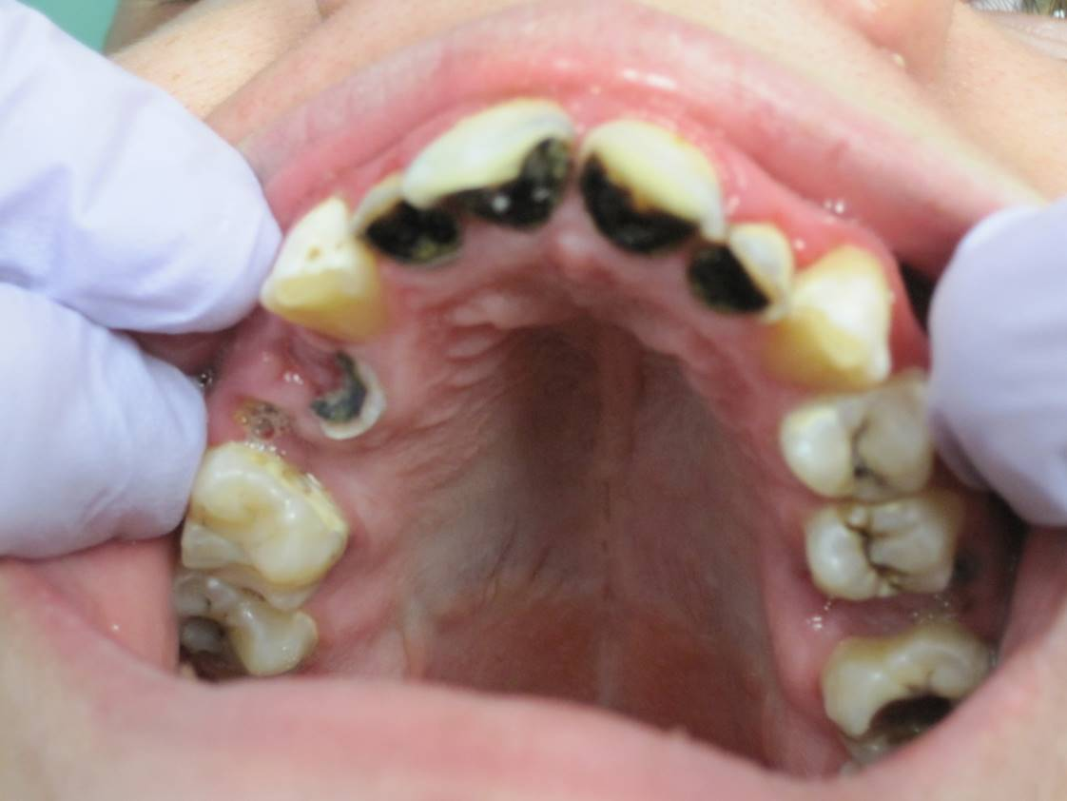
Maine Statewide survey:
Presence of Treated or Untreated Caries:
38.8% of kindergartners and 44.7% of third graders in 2019
Data from: 2019 Maine Integrated Youth Health Survey
Images courtesy of Dr. Norma Desjardins
Notes:
chrome-extension://oemmndcbldboiebfnladdacbdfmadadm/https://data.mainepublichealth.gov/miyhs/files/2019_Reports/Detailed_Reports/K3/Maine%20K_3%20Detailed%20Tables.pdf

Slide 6
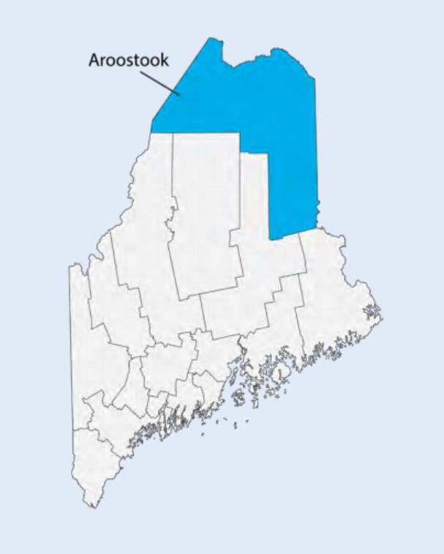
Aroostook County Stats - 2019
Data from: Maine Kids Count 2021
Demographics
Ages 0-4 | 3,200
Ages 5-17 | 9,015
Health Insurance: Ages 0-18
MaineCare | 60.1%
Uninsured | 8.3%

Slide 7
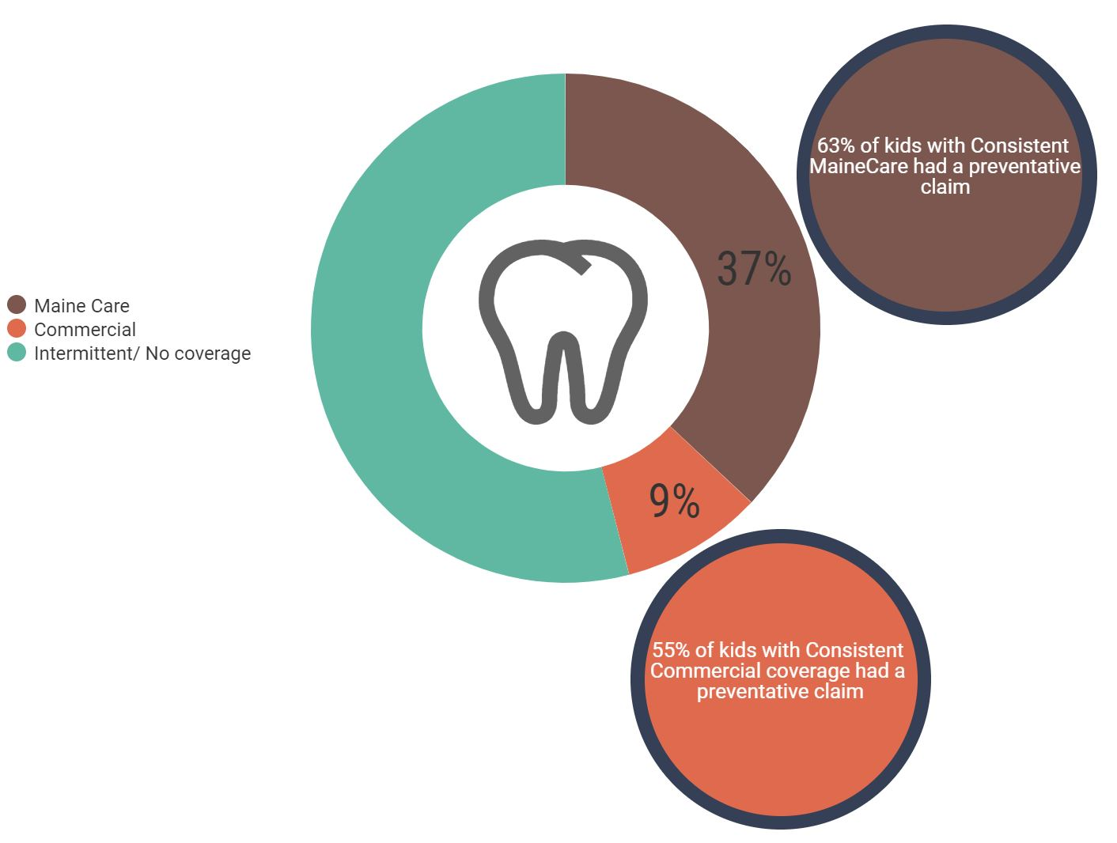
Aroostook County Claims Data:
Percentage insurance coverage out of entire AC population 0-5
There are ~3840 0-5 yr olds in the county, with ~ 600 children born every year
These numbers do not reflect those kids who had some coverage (1 month), or kids with no coverage
Notes:
Some kids don’t have insurance and don’t go to the dentist, others have families that can afford the full cost with no insurance, and some families have commercial coverage for medical but not dental. These instances are not detailed in our research due to limited data available.
Commercial preventative claims do not capture fluoride varnish applications at well visits

Slide 8
Even if kids are insured, does that mean they are receiving care?
 |  |  |  |  | Dental Home |  | Medical Home
Aroostook Head Start [2018-2019] | # of Children | MaineCare | Uninsured | Private | Yes | No | Yes | No
0 to 2 | 110 | 92.7% | 0% | 0.9% | 45% | 55% | 73% | 27%
3 to 4 | 207 | 90.3% | 0.5% | 8.7% | 75% | 25% | 84% | 16%
Among children enrolled in Head Start, 55% of kids ages 0-2 and 25% of kids ages 3-4 do not have dental homes, despite over 90% in each category having MaineCare coverage, with headstart pushing for dental homes, why don’t families have dental homes?

Slide 9
What is contributing?
Addy & Jenna from ACAP have seen a few things in the community that are contributing to lack of dental home:
Transportation
  some families that are able to find a dental home have a hard time driving there
Appointment wait-time
  long wait-list for kids to see a provider
Lack of Knowledge
  parents and caregivers don’t know when to take their kids to the dentist, or don’t prioritize dental care
Generational and Cultural Barriers
  self-fulfilling prophecy of parents believing that because they grew up with bad teeth, so will their kids
Notes:
Insurance Coverage
Dentists taking ME Care
Poor Guidance for parents on where to receive care - IKN, MECare directory

Slide 10

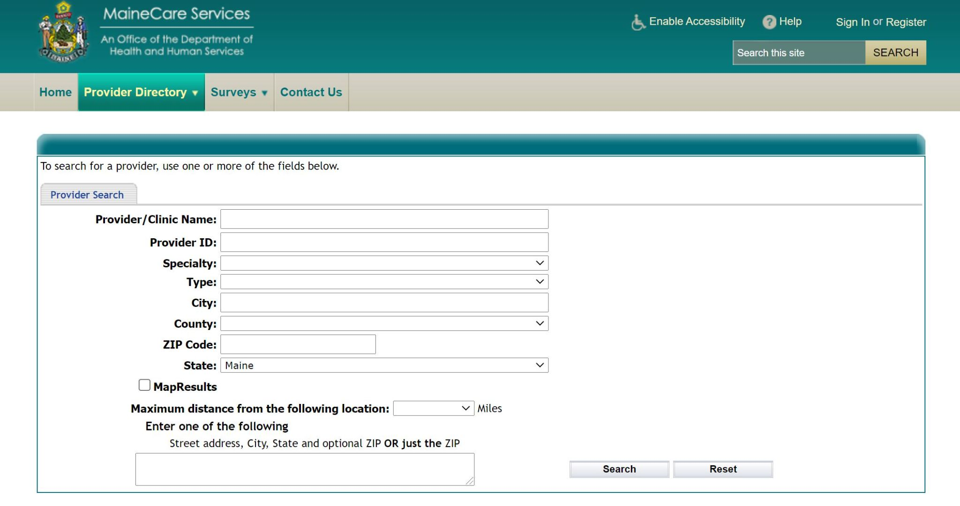
Provider Directories:
Inaccurate, hard to use, hard to find
Not for lack of trying - providers move around, and change numbers/location
Insure kids Now is easy to find, MaineCare Provider directory not so much
Notes:
We called every provider phone number listed in these directories and asked a number of questions to see if they were accepting new patients, age range and insurance policies and many were either inactive, not accepting new patients, not accepting new mainecare patients, or the wait was incredibly long. The directories are not fully up to date on who is practicing and who is accepting which patients.

Slide 11
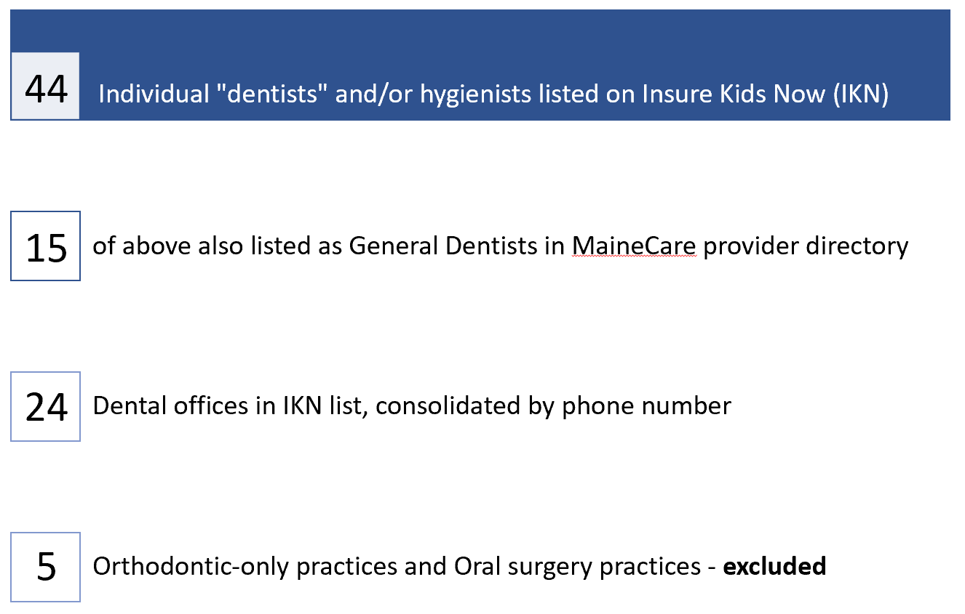

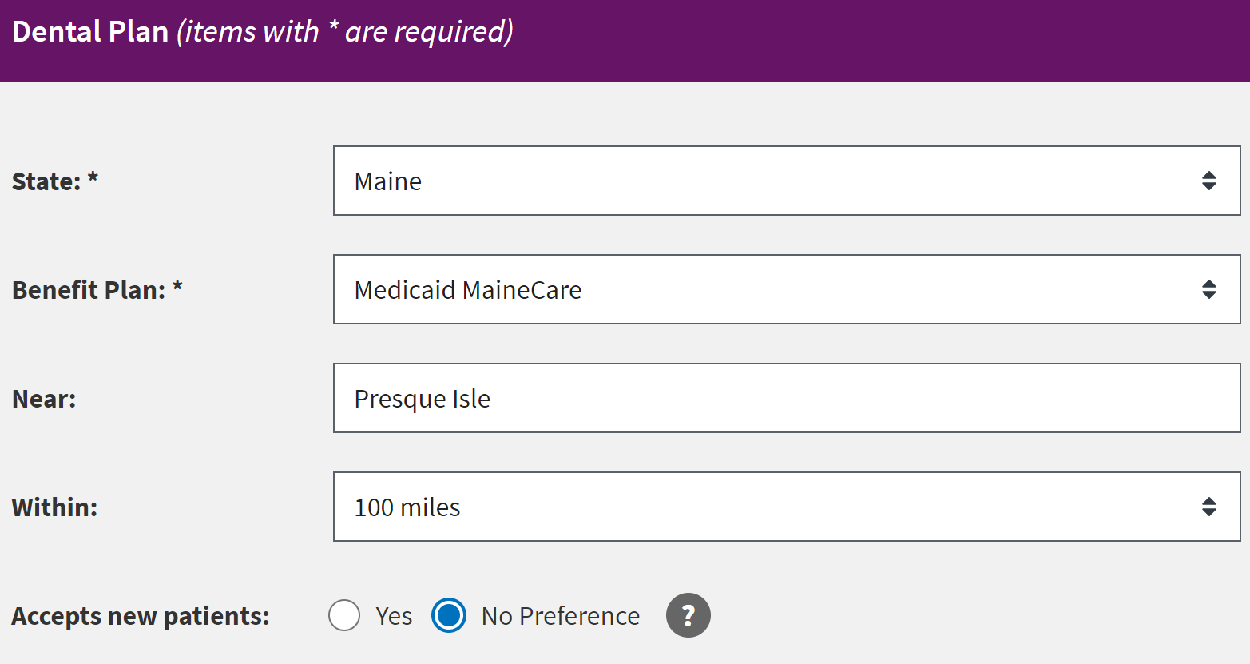
Aroostook County Search Results

Slide 12
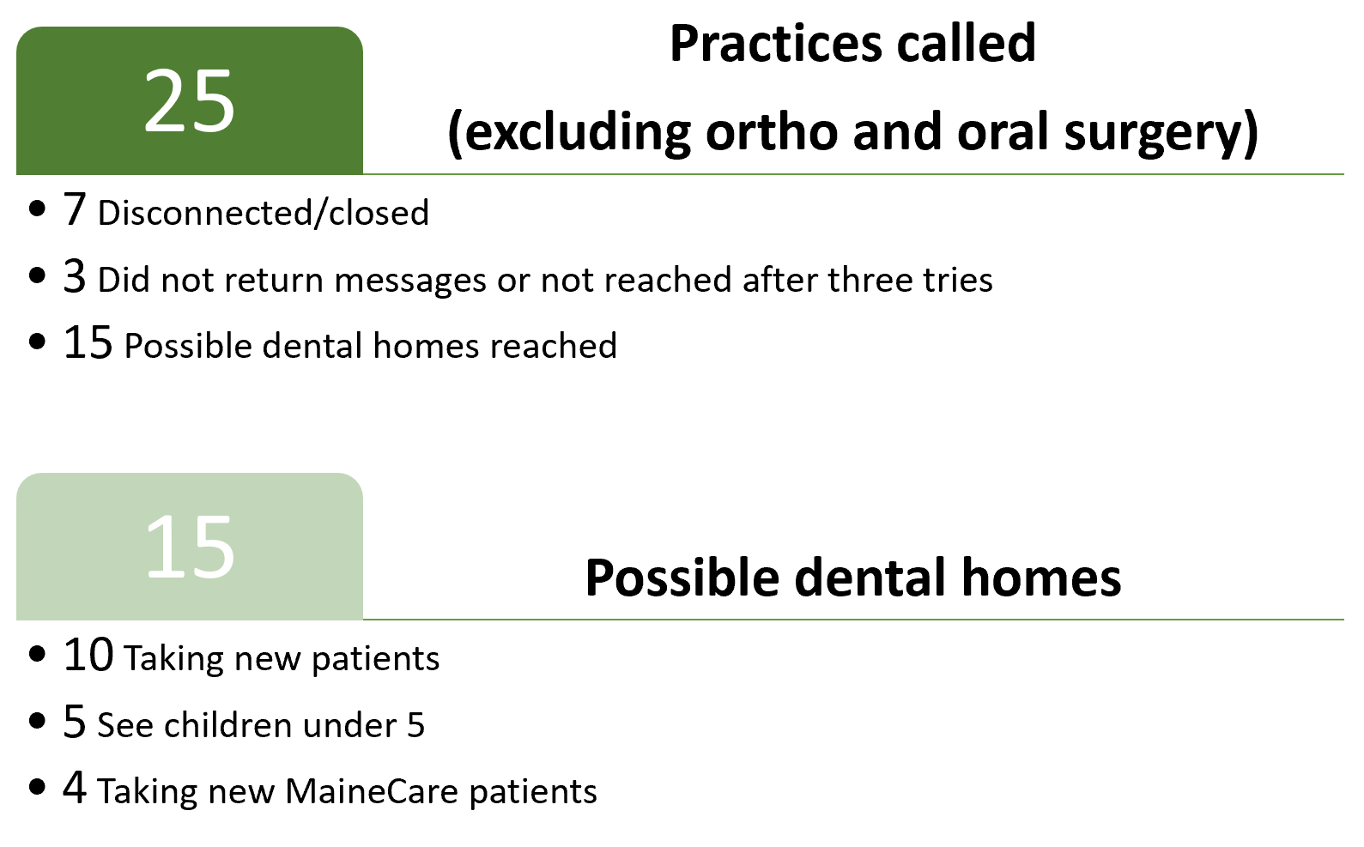
Aroostook County Call Results
Notes:
Aroostook County Call Data
Only 4 out of the 25 practices called were taking new MaineCare patients
Waitlist time ranged from as little as 2 weeks to up to 8 months
The dental practice with the shortest waiting time was unable to schedule convenient appointment times for families.
For example, a parent with 2 children would be able to schedule one child for April 6th and the second child for April 20th

Slide 13
Anecdotal Evidence - Few taking New Pts with MaineCare
ACAP
Families from Houlton often have to travel an hour away to Presque Isle for care due to limited provider availability
Families are also encountering waiting times of up to 4 months for appointments
  Waitlist time for emergency cases are just as long
  They saw one child with severe ‘rotting teeth’ having to wait 4 months for an emergency appointment

Slide 14
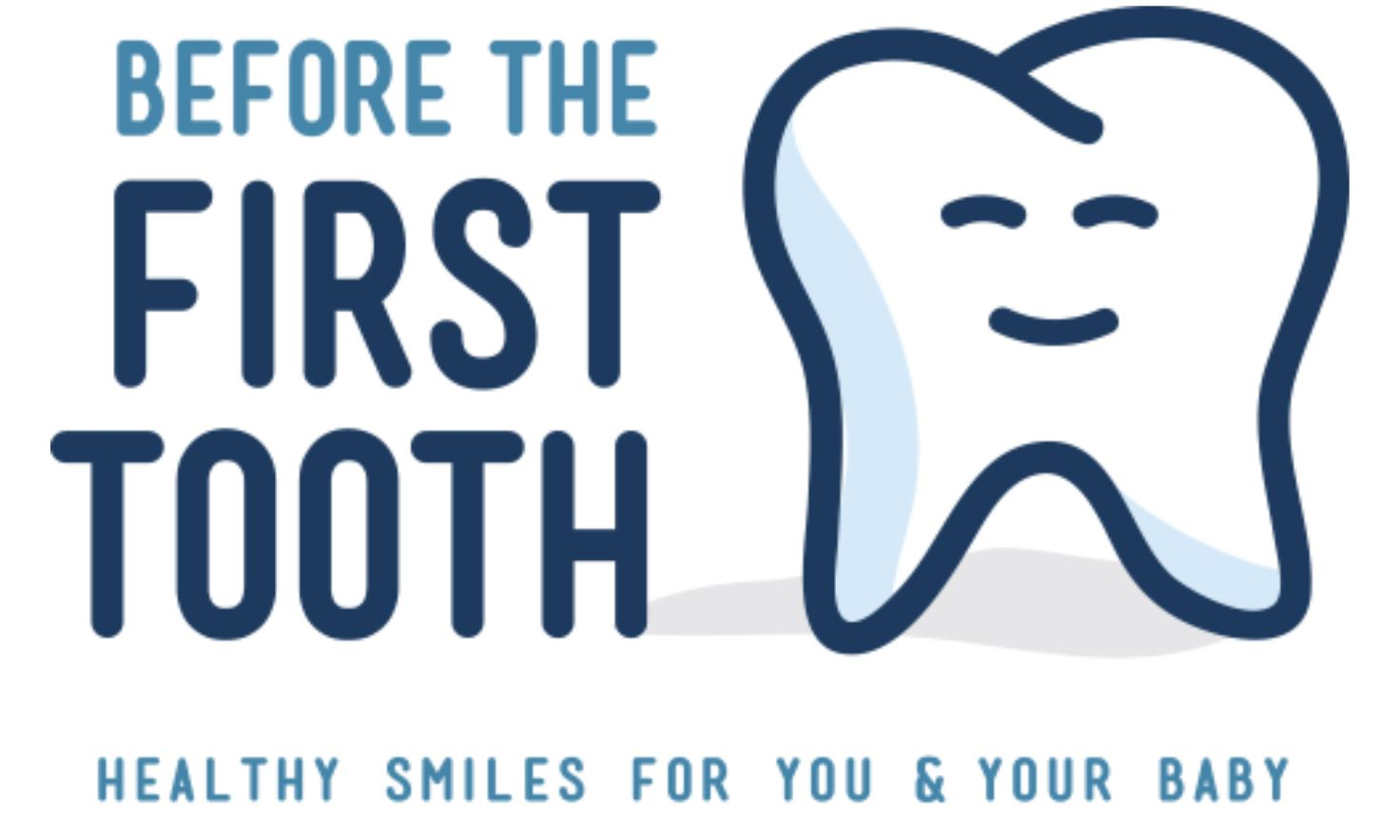
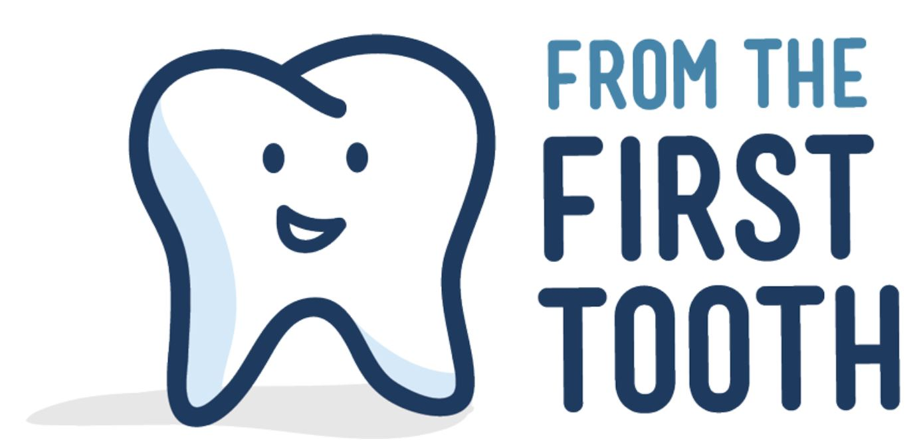
Prevention is critical
Before the First Tooth is a program which works to educate expecting parents on how to find options for dental care and how to prevent oral disease at home.
From the First Tooth promotes oral health for children, and is an initiative funded by Partners for Children’s Oral Health

Slide 15
Number of Primary Care practices serving Aroostook County : 22
(Data courtesy of Lyvia S. Gaewsky)
Implementation of FTFT -
Hard wired: 6 Partially implemented: 1 Ever Trained: 10 No training: 5
4 programs are fully implementing Before the First Tooth in Aroostook:
ACAP, WIC, Pines Health Center, and Little Feathers Head Start
Notes:
Partially implemented
Asked about 5 components of program
Someone from practice responded to survey and said they were doing some but not all of the components
Hardwired
Really worked at building it into system and EMR
Tracking info
Have process of training new providers and staff

Slide 16
Where are parents getting information?
ACAP
Jenna and Addy maintain a list of MaineCare providers
They often refer parents to St. Apollonia Dental Clinic or federally qualified health clinics such as Fish River in Fort Kent and Eagle Lake, Pines Health Services, Katahdin Valley Health Center
Lucy Morin RDH, the hygienist from ACAP, provides patient education and dental screenings 2x/year at various headstarts, elementary schools up to grade 5, and WIC clinics.
Parents may also receive referrals from their PCPs or Pediatricians
Notes:
Advanced dental cases
ACAP sends them to any place that might be close to them. If a child lives in the Houlton area theymight send them to KVHC (Katahdin Valley Health Center). They are located in both Houlton and Ashland. To Norma (St Apollonia), Pines Dental in Caribou, Fish River Rural Health up in Fort Kent.
Sometimes a family from another town might want to go to St Apollonia. ACAP gives families information and options that would be available

Slide 17
What can we do to intervene?
Over 600 babies born in Aroostook County in 2019 - only 4 out of 25 practices in the region are accepting new MaineCare patients, when roughly 185 of those babies will have MaineCare. Only 10 practices are taking new patients in total in the region.
This stage of life is critical for starting good habits with parents and educating them on proper oral hygiene.
+ What would it take to create a system where these babies can have an oral wellness check with oral health information for parents?
+ Is there any room for Telehealth to be used as a way to connect parents without the hassle of transportation?
+ How can we centralize our efforts to know who is doing what and where patients can receive care?
+ What should be some goals for getting dental homes for 0-2 year olds and how can we get there?

Slide 18

Suggestion: World Café
We want to hear the thoughts, ideas, and initiatives from the stakeholders in the community in the form of a World Café!
Anyone who attends will be able to comment, contribute, or just listen and be a part of a flow of brainstorming to better the community they live and work in.
By the end, we should be able to piece together what we have heard and contributed in order to find solutions that are beneficial to our target population as well as sustainable for the community.

Slide 19
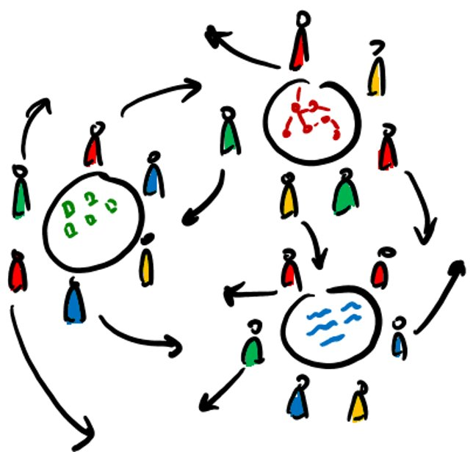
World Café: Method
Introductions
Small round table discussions (break out rooms) with posed questions and lively discussion
Small round tables come together, and ideas are shared and presented to the larger group for further discussion.

Slide 20
Questions, Comments, Interest?

